Slide 1
Wooden chair Testing
Oksana Sul

Slide 2
Requirements 1.GUI:
ID | Requirement
GUIR1 | Length of the chair: 0,7 m
GUIR2 | Length of leg: 0,68 m
GUIR3 | Form of seat place: circle
GUIR4 | Form of seat plase: circle
GUIR5 | Color: colorless(natural color)
GUIR6 | Material: all components are made of wood except metallic details
GUIR7 | Weight: 5 kg
GUIR8 | All of the wooden details have to be saturated with natural drying oil and then washed with colorless varnish
GUIR9 | There have to be no splits and knots in the wood
GUIR10 | All metallic details have to be situated under a seating place

Slide 3
2.Functional:
ID | Requirement
FUNCR1 | Details for mounting should be available in a complete set: 24 metallic bolts, 1 wooden seat, 4 wooden legs, 8 wooden stick
FUNCR2 | The dampness of wood has not to exceed 15 %
FUNCR3 | Moisture-resistant varnish has to be used for wooden details
FUNCR4 | There have to be available 4 rubber protectors on legs of the chair to prevent sliding on all grounds
FUNCR5 | Maximum weight recommendation: 150 kg
FUNCR6 | You could use the chair after 5 times throwing
FUNCR7 | The quality of covering has to provide future normal exploitation after putting hot metal things during 10 min
FUNCR8 | The quality of covering has to provide future normal exploitation after continuously keeping the chair in the sun for 30 days
FUNCR9 | The quality of covering has to provide future normal exploitation after continuously keeping the chair in water for 12 hours
FUNCR10 | The chair has to perform in houses and factories for 2 months without failures

Slide 4
Testing Types
Smoke Testing
GUI Testing
Functional Testing
Load Testing
Confirmation Testing
Regression Testing

Slide 5
Smoke Testing
ID | Test case idea | Actual result
TC1 | Verify the complete set for mounting | Pass
TC2 | Put all components together, use the installation manual | Pass
TC3 | Verify the ability of the chair to stay on the floor | Pass
TC4 | Sit on the chair | Pass

Slide 6
GUI Testing
ID | Test case idea | Actual result
TC5 | Verify the dimensions of the chair and it’s details due to the specification | Pass
TC6 | Verify the evenness of the surface | Pass
TC7 | Verify coverage of wooden details | Pass
TC8 | Verify the color of the components. They have to be colorless (natural) | Pass
TC9 | Verify the presence of 4 rubber protectors and the ability not to slide on parquet, concrete, carpet and linoleum | Fail (There is just 3 rubber)
TC10 | Weigh the chair. The weight of the chair has to be 5 kg | Pass
TC11 | Measure the length. The length of the chair has to be 0,7 m | Pass
TC12 | Look at the surface. The surface has to be without splits and knots | Pass

Slide 7
Functional Testing
ID | Test case idea | Actual result
TC13 | Verify ability to sit on the chair (general object with weight up to 150 kg) | Pass
TC14 | Verify ability to use the chair after 1-time throwing | Pass
TC15 | Verify coverage of wooden details after 1- time throwing | Pass

Slide 8
Load Testing
ID | Test case idea | Actual result
TC16 | Verify the ability to perform in different types of environments: house and factory for 2 months without failures | Pass
TC17 | Verify the ability to use the chair after 5 times throw (general object with weight up to 150 kg) | Fail(leg of the chair had been broken after 3 times)
TC18 | Verify coverage of wooden details after continuously keeping the chair in the sun for 30 days | Pass

Slide 9
Confirmation Testing
ID | Test case idea | Actual result
TC9 | Verify the presence of 4 rubber protectors and the ability not to slide on parquet, concrete, carpet and linoleum | Pass
TC17 | Verify the ability to use the chair after 5- time throwing (general object with weight up to 150 kg) | Pass

Slide 10
Regression Testing
ID | Test case idea | Actual result
TC6 | Verify the evenness of the surface | Pass
TC7 | Verify coverage of wooden details | Pass
TC12 | Look at the surface. The surface has to be without splits and knots | Pass
TC15 | Verify coverage of wooden details after 1- time throwing | Pass

Slide 11
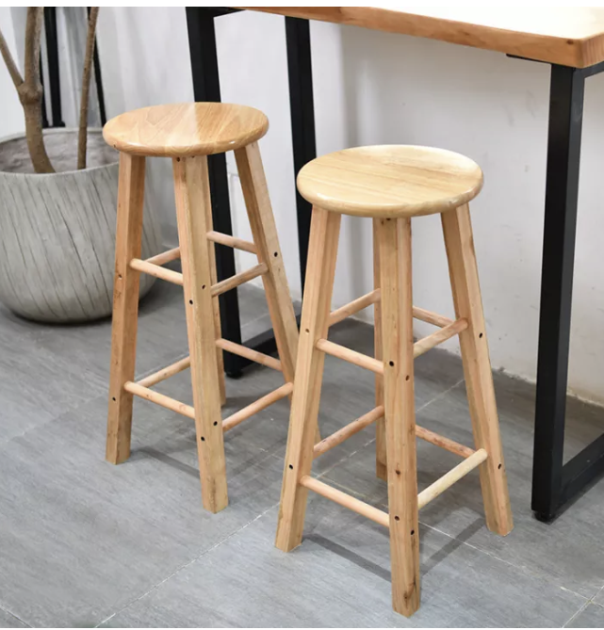
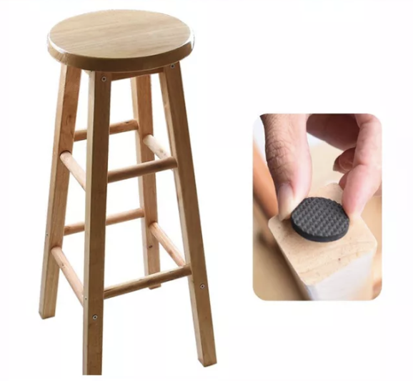
Mockups

Slide 12

Thank you!

